Slide 1
NHS Data Engineering Project: Enhance Patient Care through Cutting Edge Solution Presented by: Rita Uzoka Date: 5th August 2024

Slide 2
Background: AnyHospital, a leading healthcare institution, is dedicated to the continual enhancement of patient care through innovative approaches. Acknowledging the transformative potential of data-driven insights, the hospital has embarked on a strategic initiative to harness the power of its extensive medical records. The Hospital plans to leverage cloud technologies to propel healthcare research, with a primary focus on disease prediction, prevention, and better patient care/experience. Clinicians, IT personnel, management, and patients are the stakeholders.

Slide 3
In pursuit of this mission, the Hospital recognizes the need to adopt cutting-edge solutions to effectively analyze and extract meaningful insights from vast and diverse medical datasets they collect. The objective is to harness their data assets for making informed decisions and accomplishing their business objectives by navigating the intricacies of data management, analytics, and strategy by offering knowledge, direction, and advice. Relevance: - Facilitate data-driven choices to improve patient outcomes and healthcare delivery. To address this challenge, the hospital is implementing a data analytics solution on Azure, to enable seamless and efficient querying and analysis of medical data.

Slide 4
Business Requirement - A daily report of admitted Patients and discharged Patients - How long between admitted and discharged Patients - A daily report of diagnosis and treatment of patients - A daily report of scans and tests done - A daily report with the gender and age of patients

Slide 5
Conceptual Modelling Decision on Technology/Infrastructure - Ingestion: Azure Data factory (ADF) is best suited for ongoing ingestion of files from onprem database to azure. -Storage: Based on the CAP Theorem, Azure sql database was chosen because in rare partition instances, it may temporarily become unavailable while providing high availability characteristics, because its primary goal is to guarantee data accuracy and consistency. -Visualization: easy compatibility with Microsoft applications, affordable licensing, intuitive user interfaces, wide data connectivity, and robust security features,PowerBI appeared to be most suitable.

Slide 6
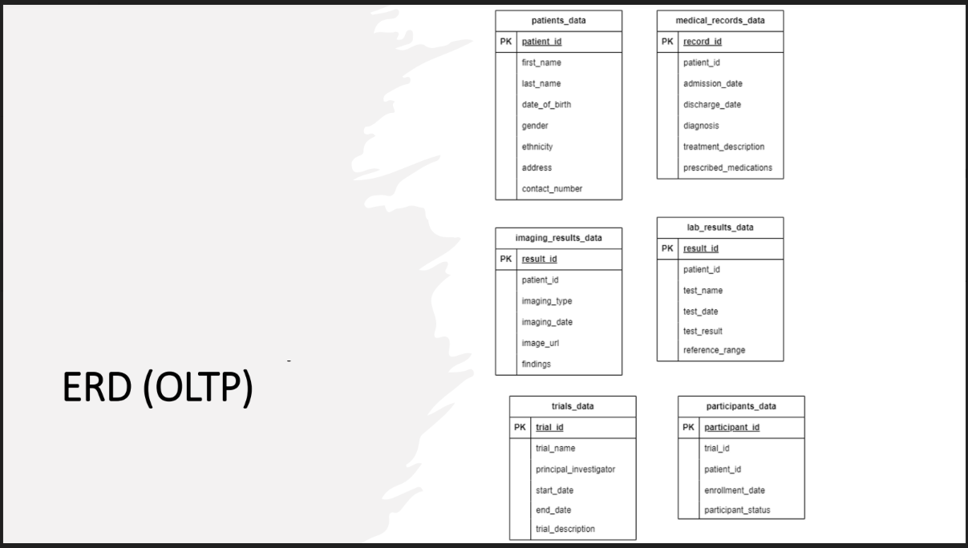
OLTP Entity Relationship Diagram(ERD)

Slide 7
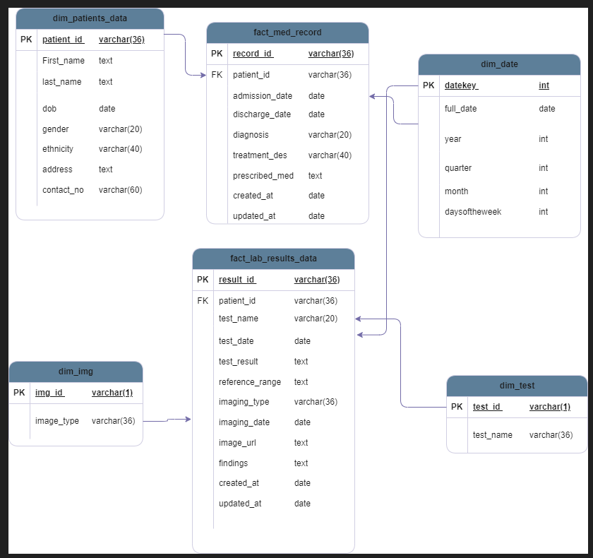
AnyHospital Star Schema

Slide 8
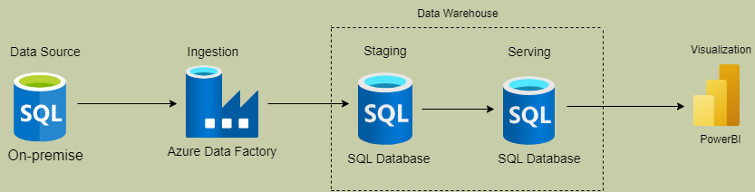
Solution Architecture:

Slide 9
Data Solution(ETL Process): - Ingest data frequently from on-prem sql database to azure sql database. - Transform data into the star schema model for seamless extraction of business reports. - Load data into production Datawarehouse for analysis and visualization.

Slide 10
Project Challenges: 1.Avoid Extraction of Duplicate record 2.Efficient Incremental data process 3.Different schemas 4.Different keys

Slide 11
Solution to Challenge 1: Avoid Extraction of Duplicate record Watermark Table When processing data in batch or streaming mode, a watermark table is a useful tool for monitoring the progress of the processing. When it comes to managing late-arriving data and preserving the state of incremental data processing, watermark tables can be extremely helpful in ensuring that data is processed precisely once. -Watermark tables store metadata about the current state of data processing -By monitoring the most recent processed timestamp, they assist in handling data that arrives late. Watermark tables facilitate incremental data processing by allowing systems to process just data that has changed or been added since the last update. This improves efficiency and speeds up processing. - The watermark table – stores the table names and the last updated time, this table is in the Sink - The Old watermark table(Old WM)-this table is updated from the last updated time at the watermark table - The New watermark table(New WM)- this table is updated from the last updated time at the source table. Therefore the Source data will copy data that falls between the Old WM and the New WM

Slide 12
Data Pipeline Solution for Challenge 2: - Extract first row of the watermark value of the watermark table(OLDWM) and first row of the Max(updated at)column of the source data(NEWWM). - Extract data from source within the range of OLDWM and NEWWM - Upsert the data into destination using keys - Update the watermark table(NEWWM) using stored procedure.

Slide 13
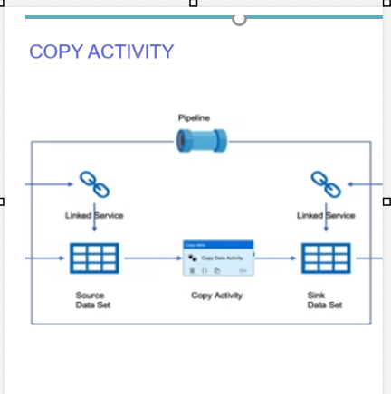
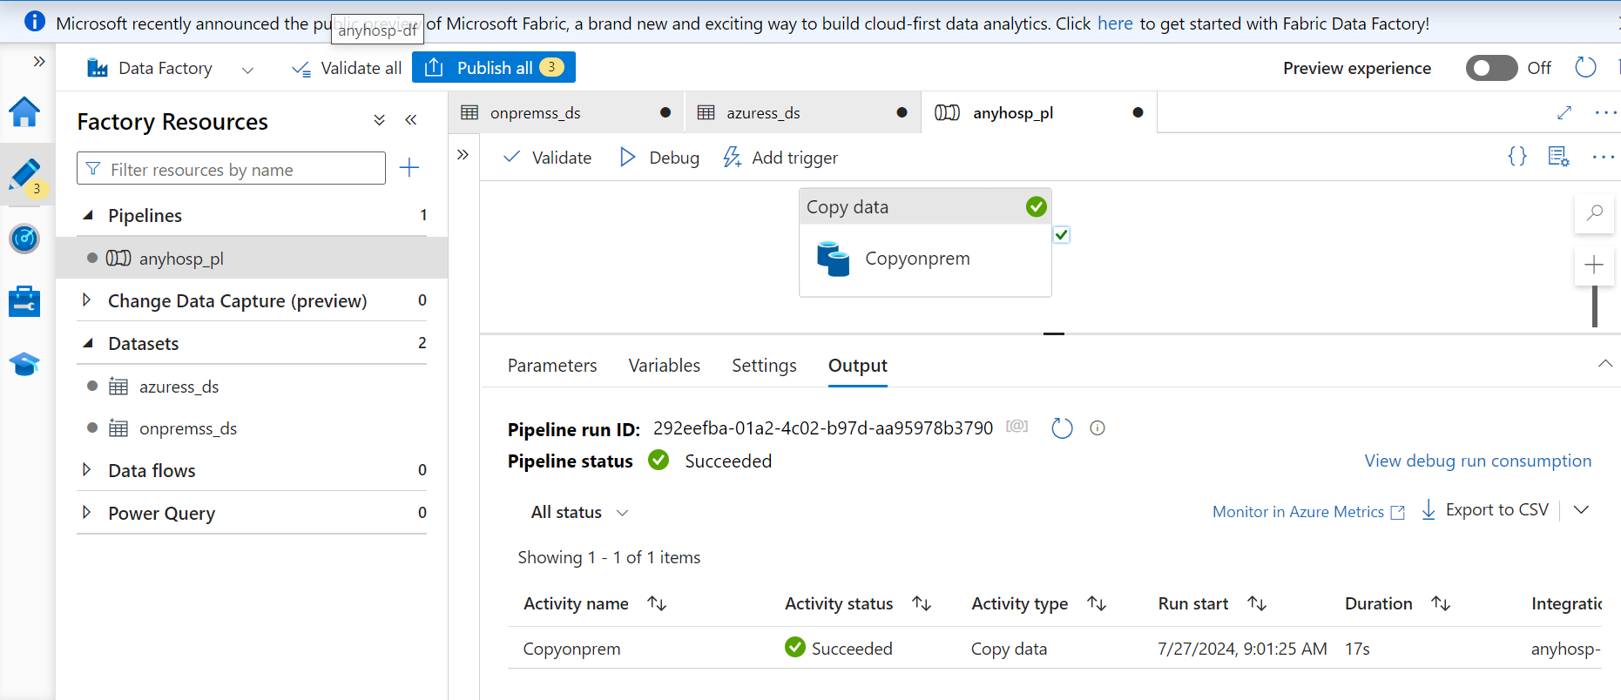
Data Ingestion
ADF-Copy Activity

Slide 14
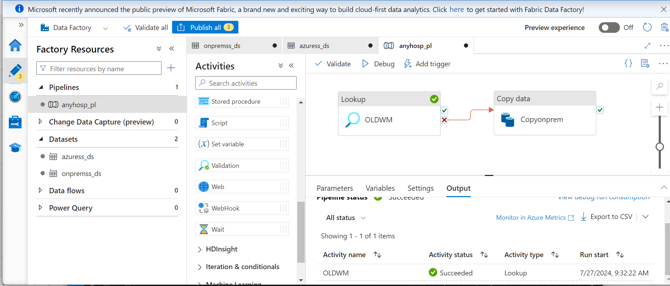

Slide 15
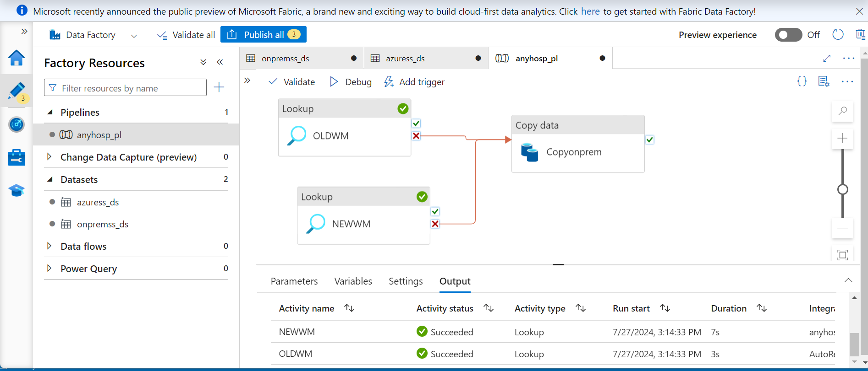

Slide 16
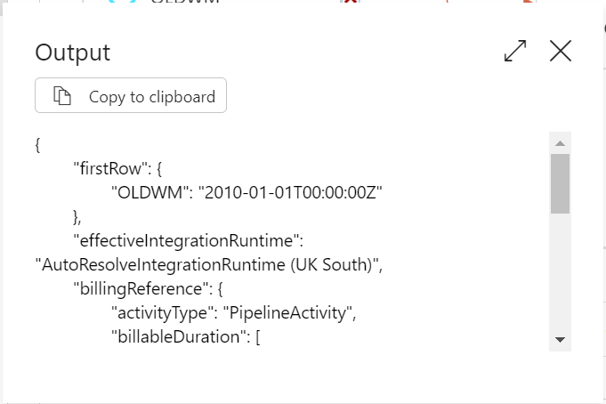
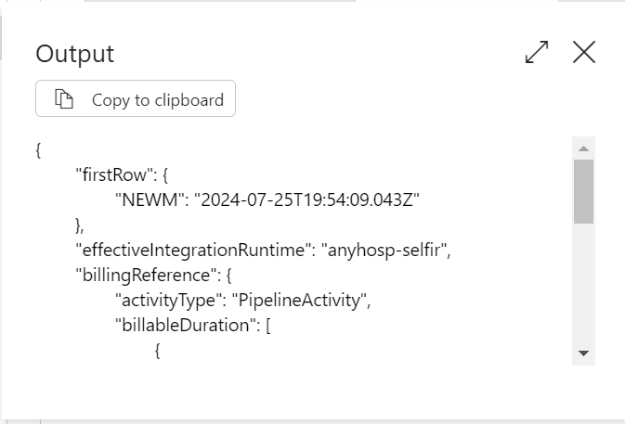
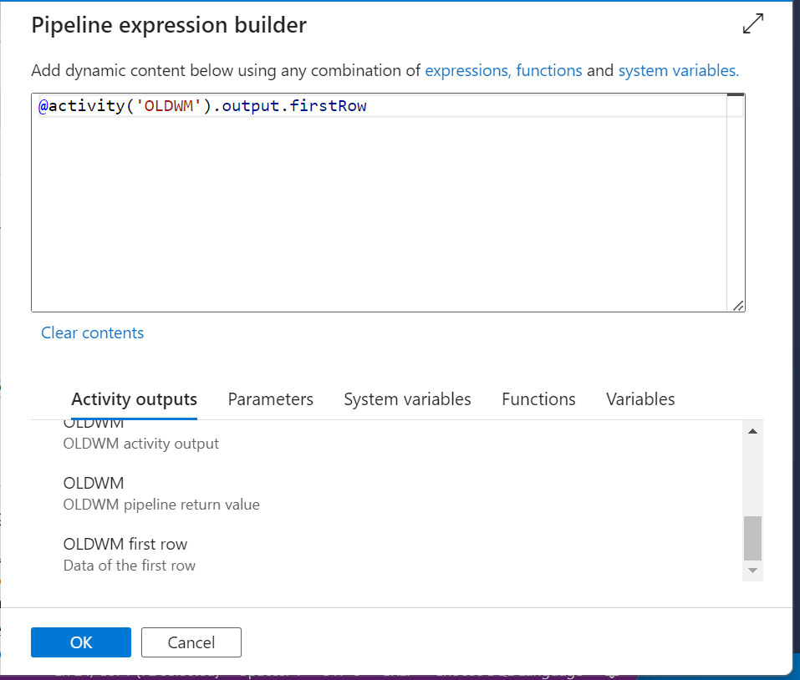
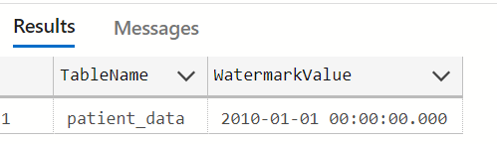
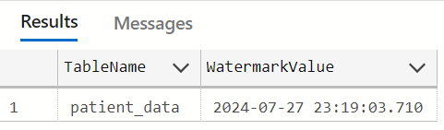
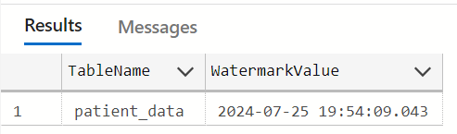
Dynamic Pipeline:

Slide 17
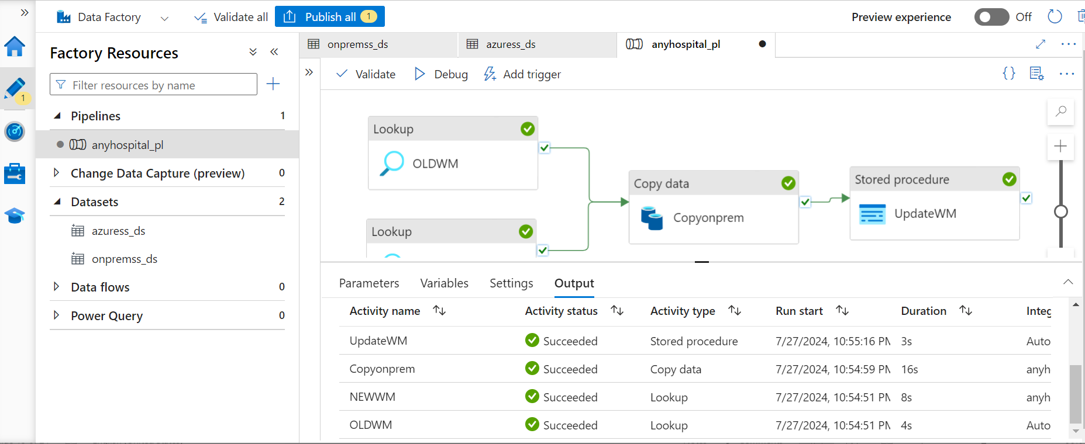
Dynamic Pipeline:

Slide 18
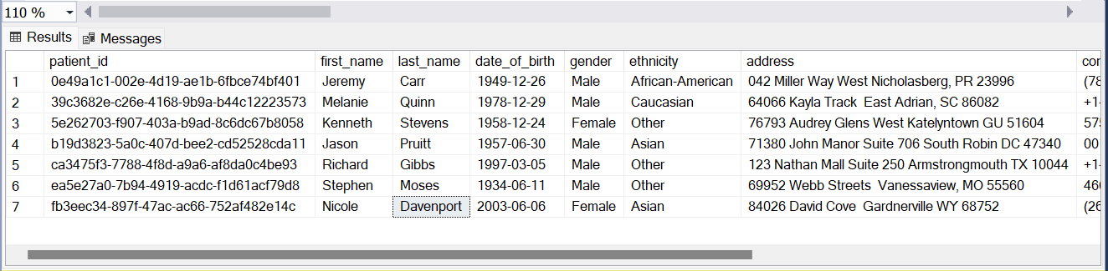
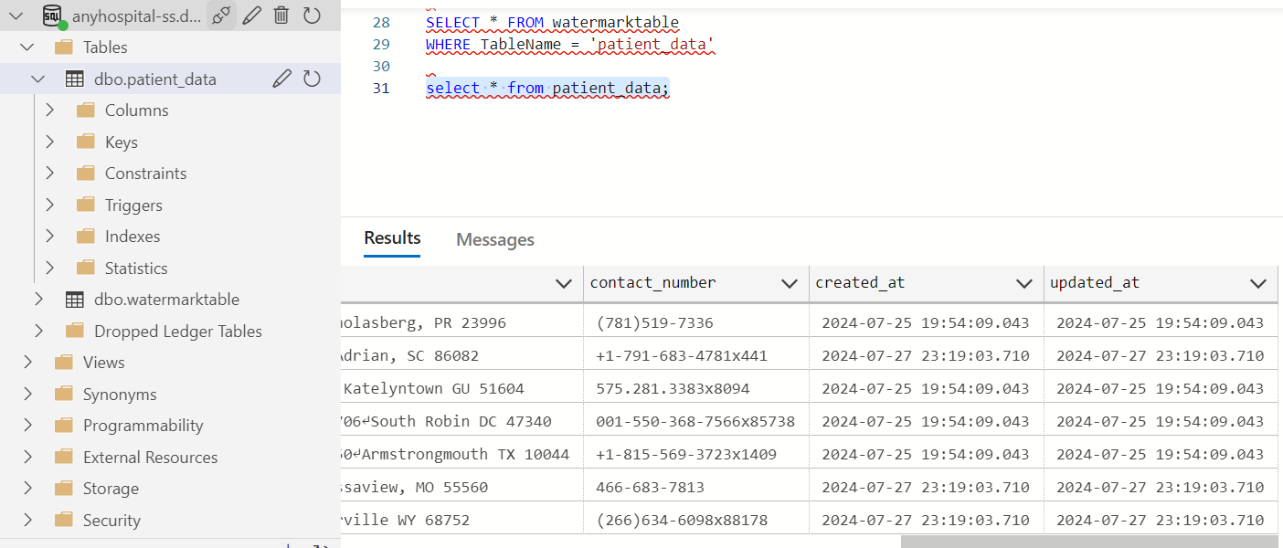
Dynamic Pipeline:

Slide 19
Solution to Challenge 3 and 4 :Metadata driven Pipeline Metadata is the data related to the structure of the table or pipeline Need to design a pipeline for multiple tables Options: -Loop -Pipeline Parameters [{"TABLE_NAME":“patient_data","WaterMark_Column":"updated_at","MERGE_KEY":[“patient_id"]},{"TABLE_NAME":“medical_records_data","WaterMark_Column":"updated_at","MERGE_KEY":[“record_id"]}]

Slide 20
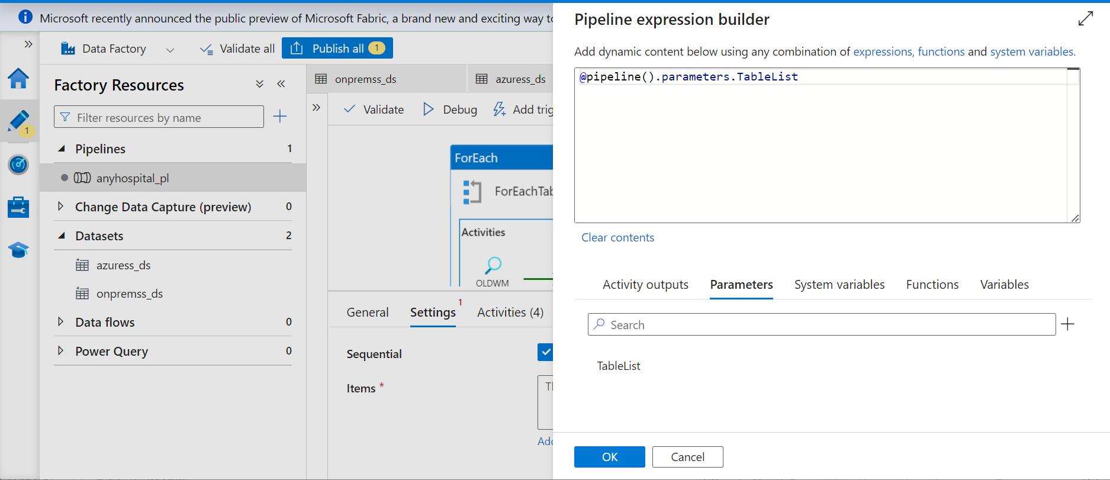
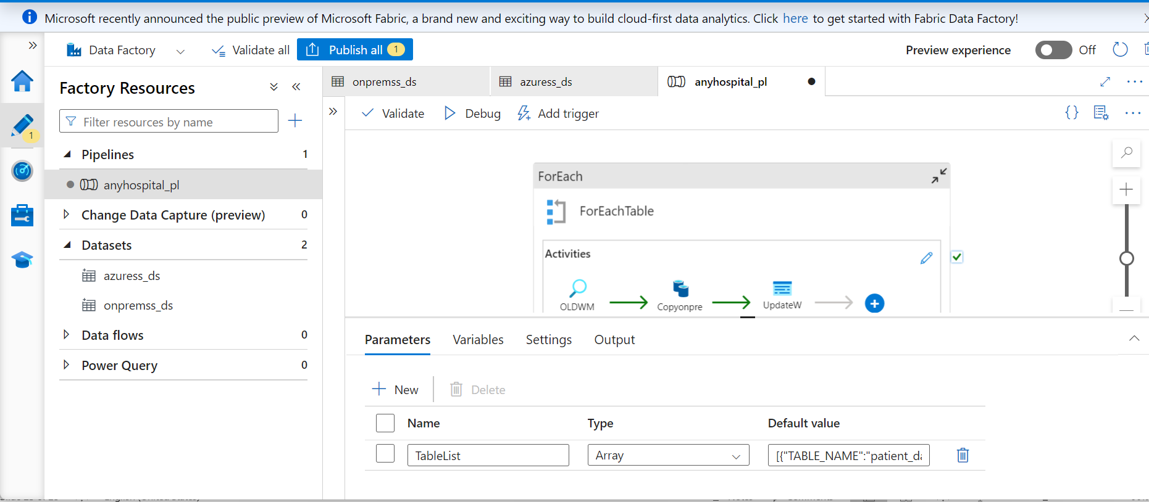
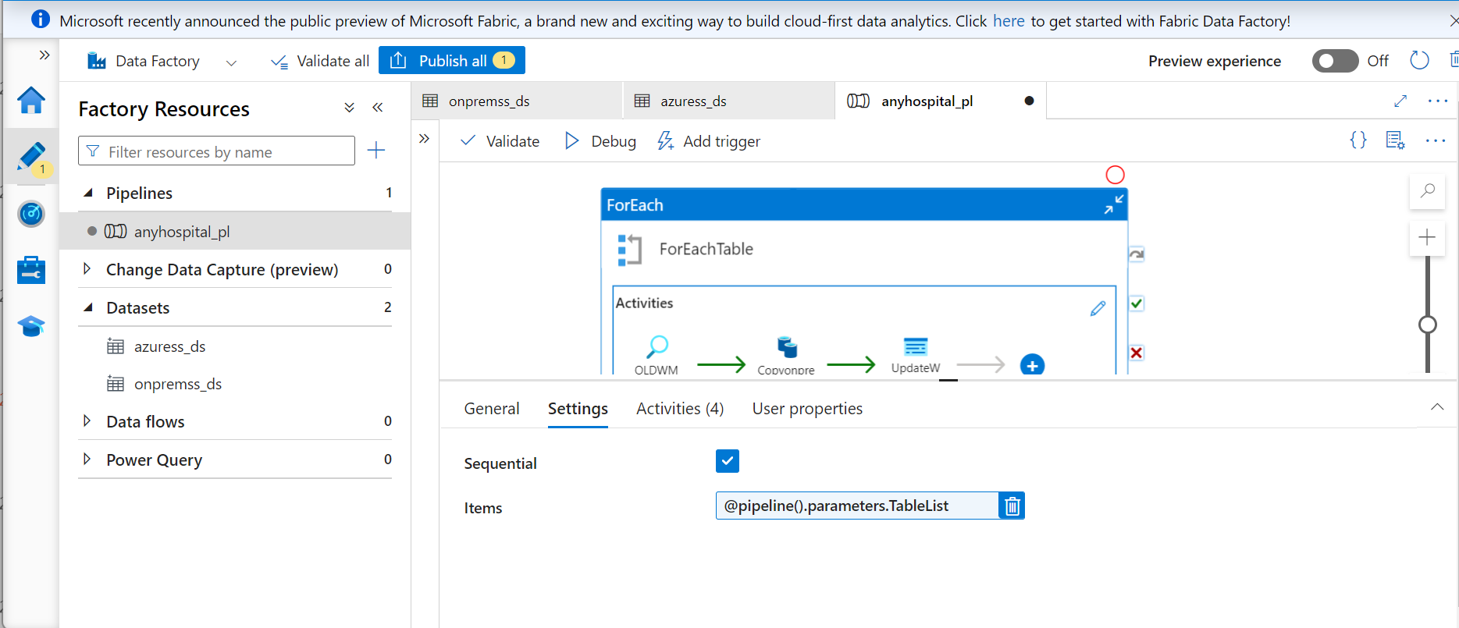
Solution to Challenge 3 and 4 :Metadata driven Pipeline

Slide 21
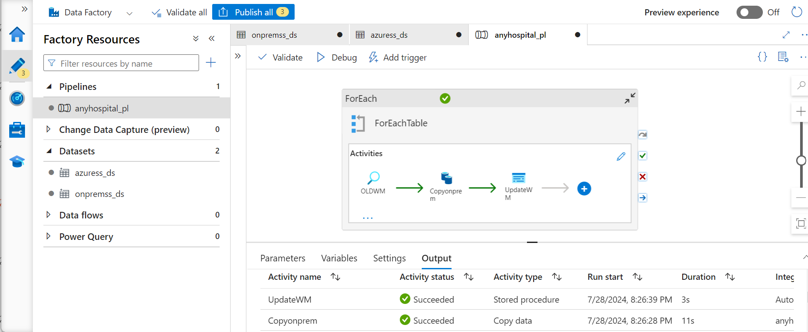
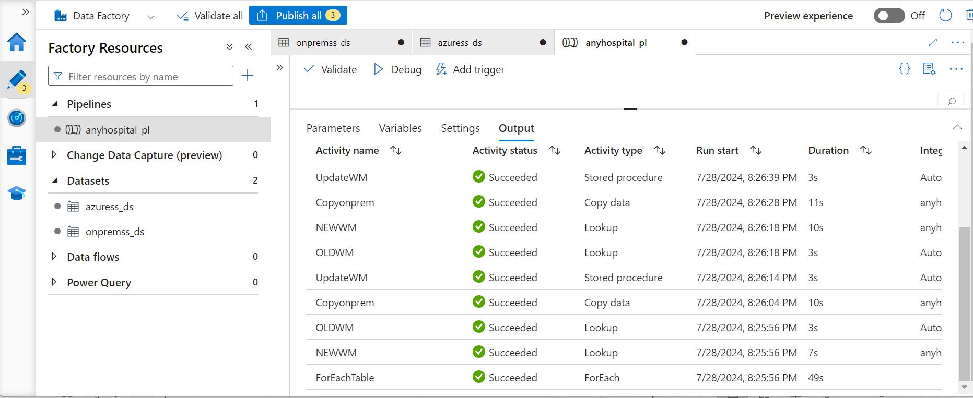
Solution to Challenge 3 and 4 :ForEach Loop

Slide 22
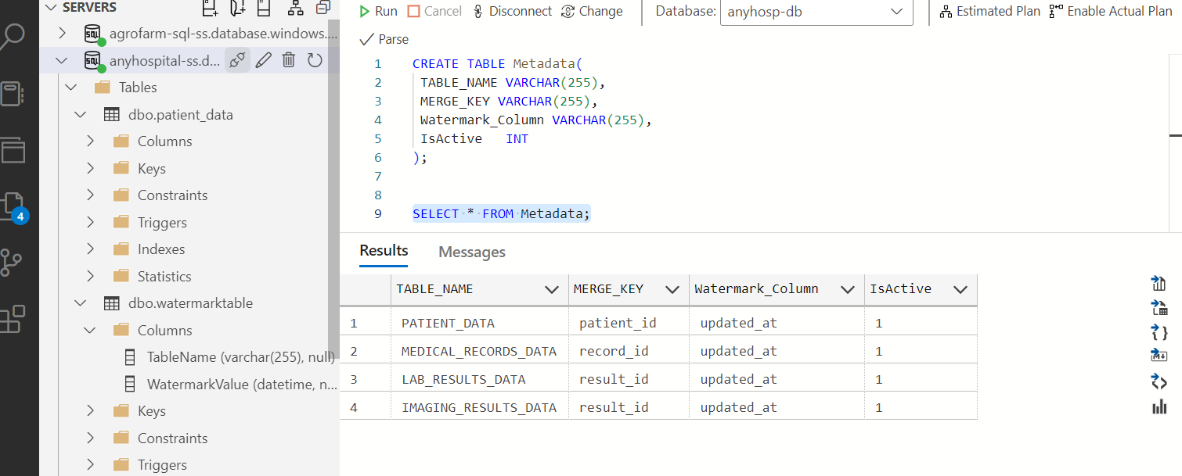
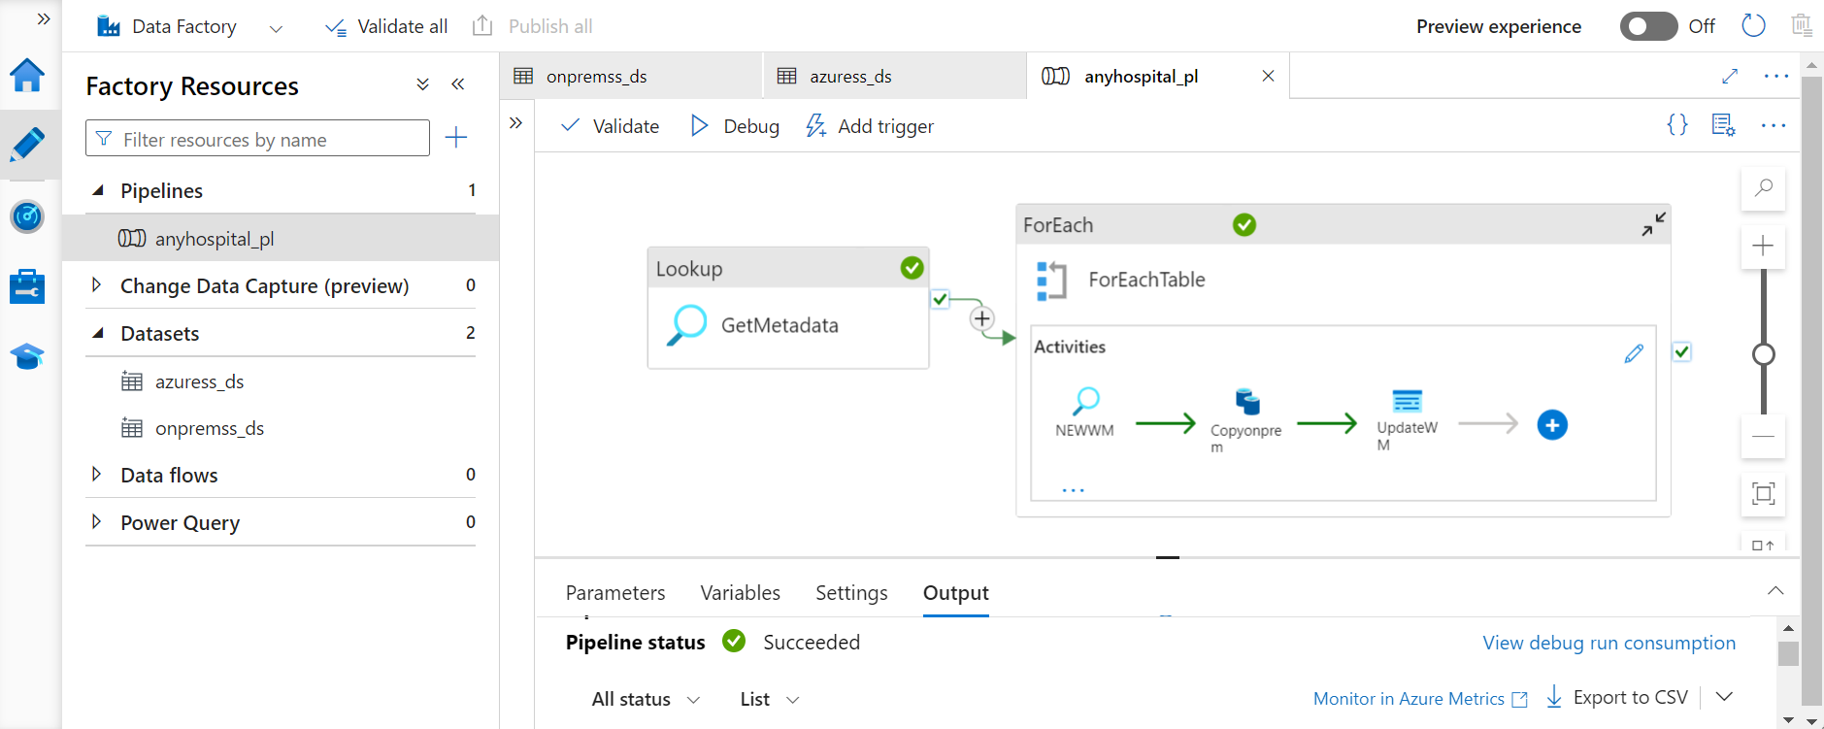
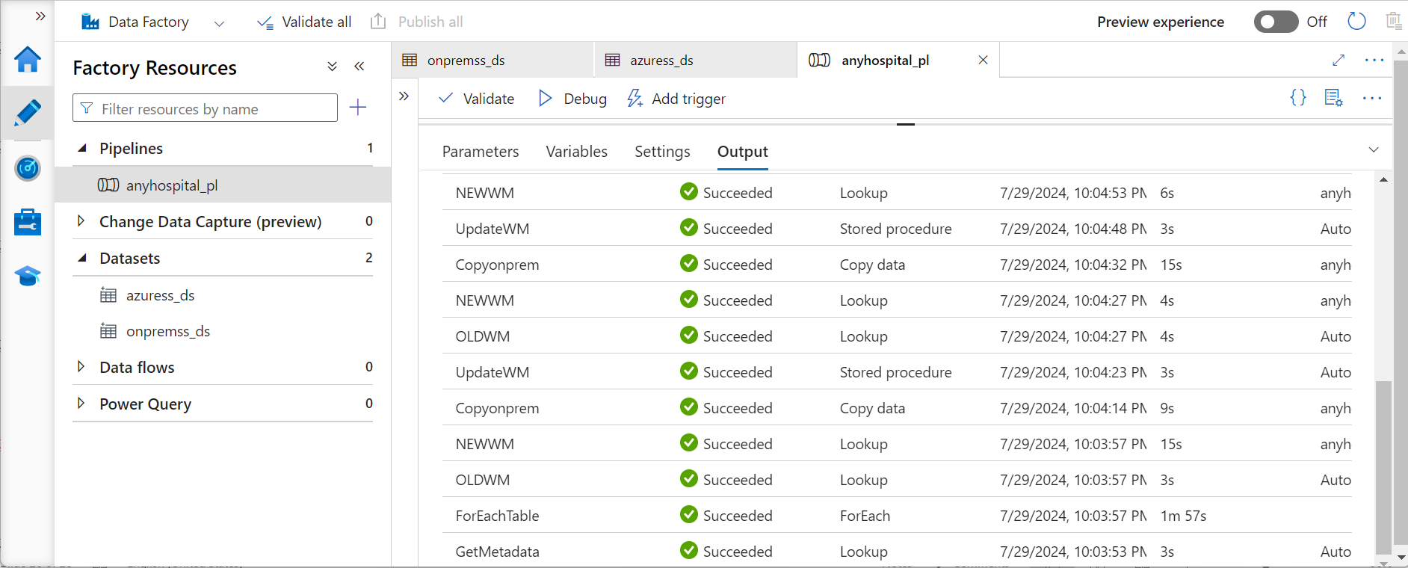
Metadata Table was created in the sink to complement the pipeline parameters

Slide 23
Transformation and Load: 1. Created a serving/production database 2. Created tables as per production schema 3. load data into tables to be used for visualization. This activity was added to the pipeline using stored procedure - A stored procedure was created in the sink to load data into the production tables from the staging tables.

Slide 24
Outcome: 1.We improved the processing time for daily medical reports to provide near real-time analytics for business decision. 2.The analytics platform performed much better as a result of this project, which led to a 30% increase in operational efficiency and the creation of new initiatives. 3.Increased data accessibility and scalability and cut operational costs by 15% by moving clients data infrastructure to Azure.

Slide 25
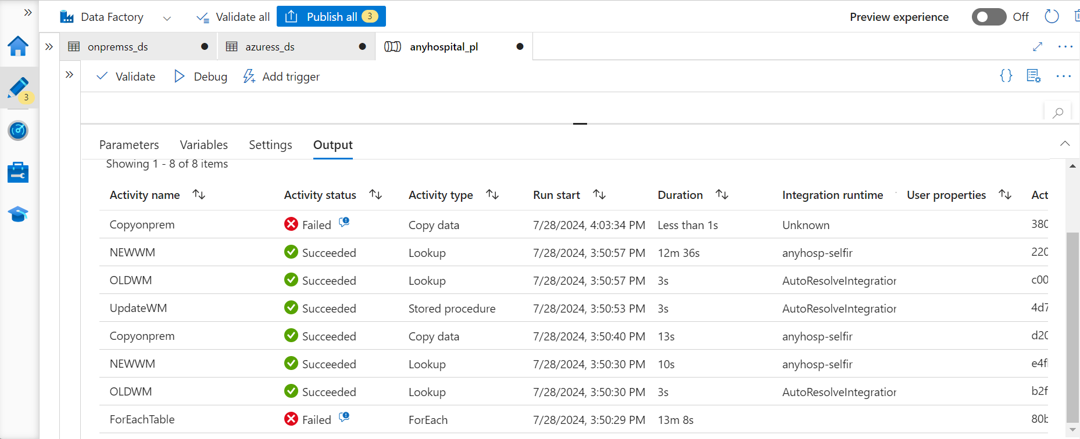
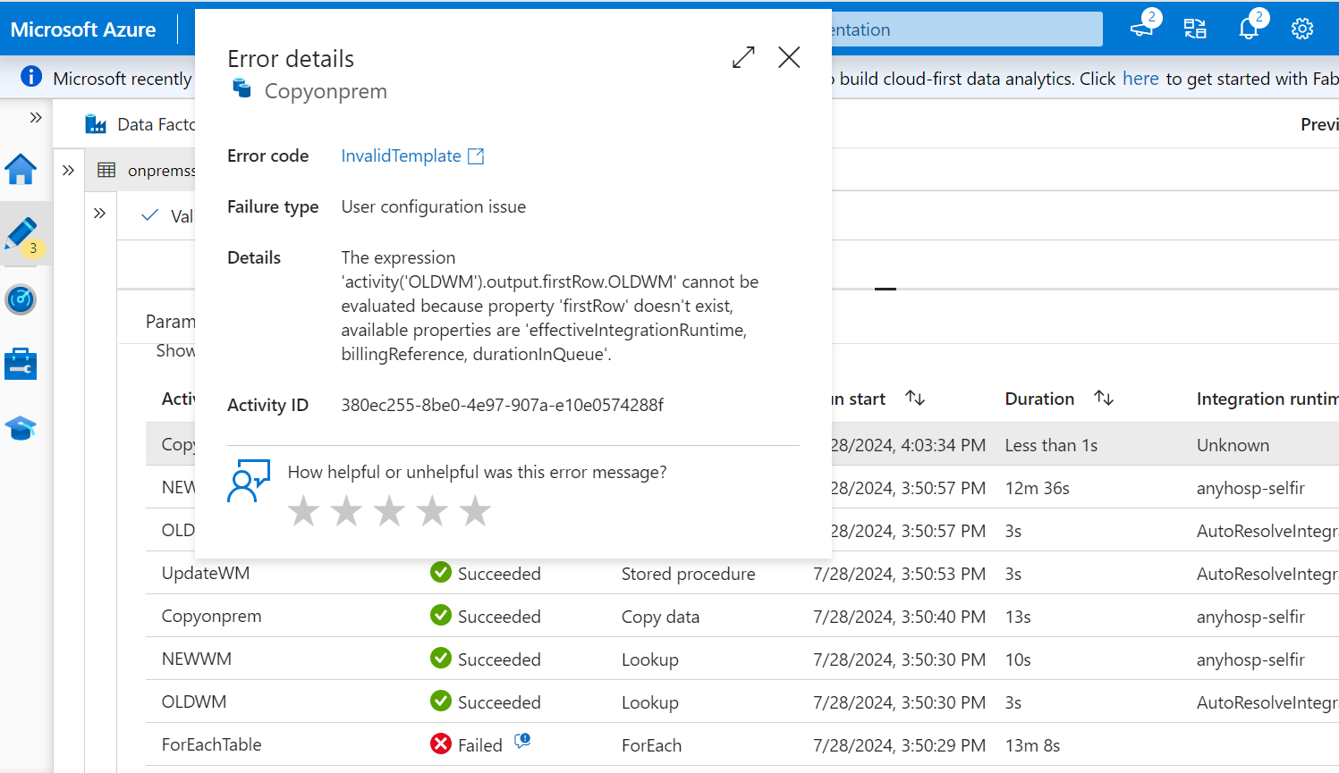
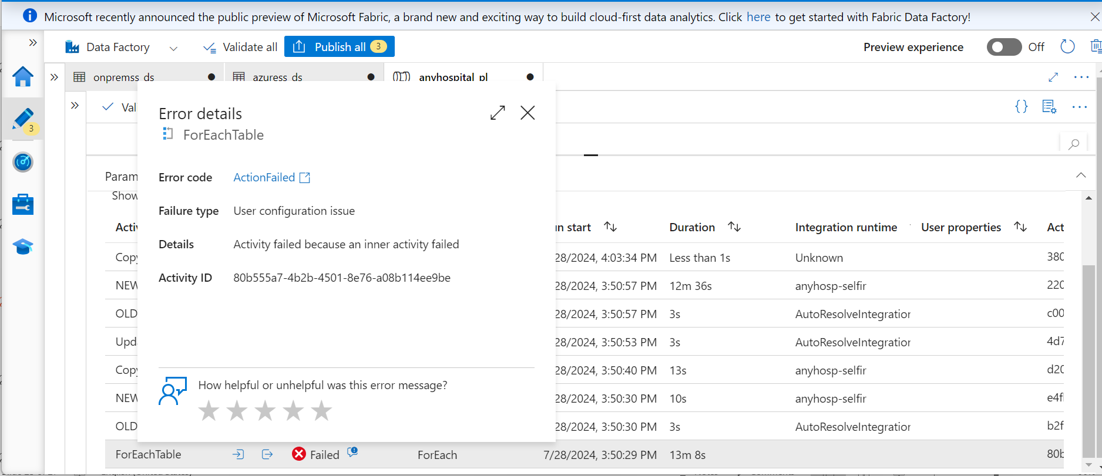
Errors encountered in the Project

Slide 26
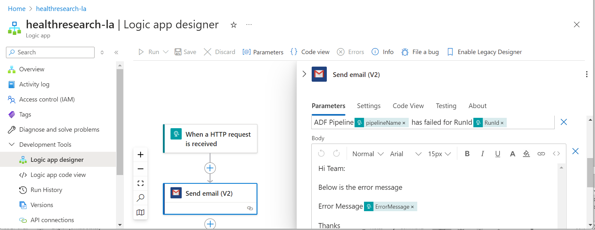
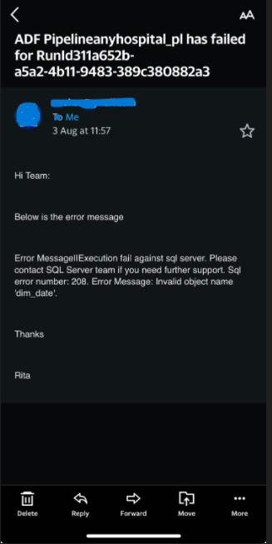
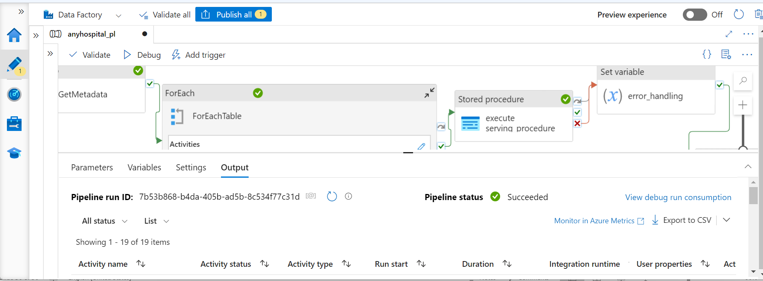
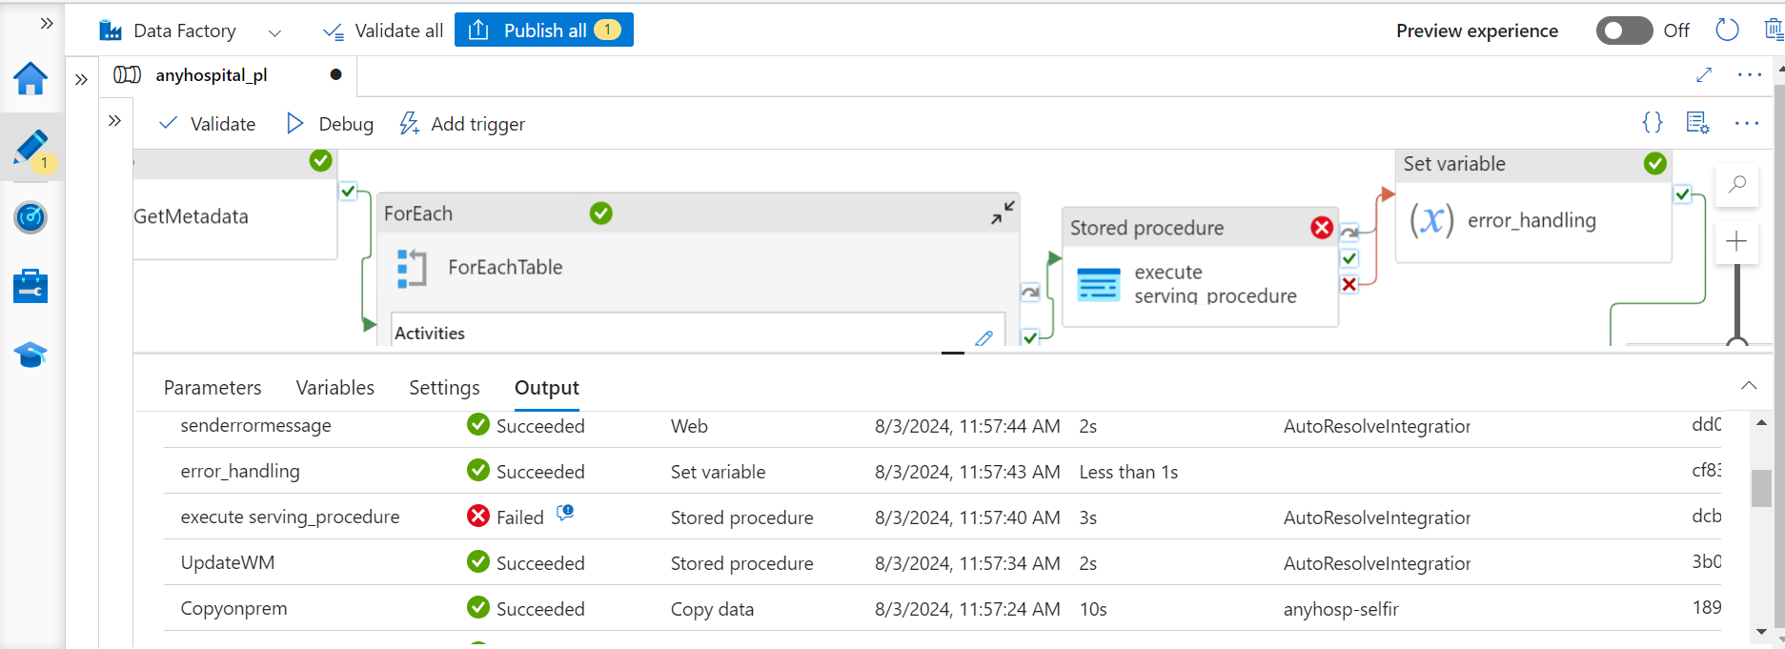
Error Notification: Logic Apps

Slide 27
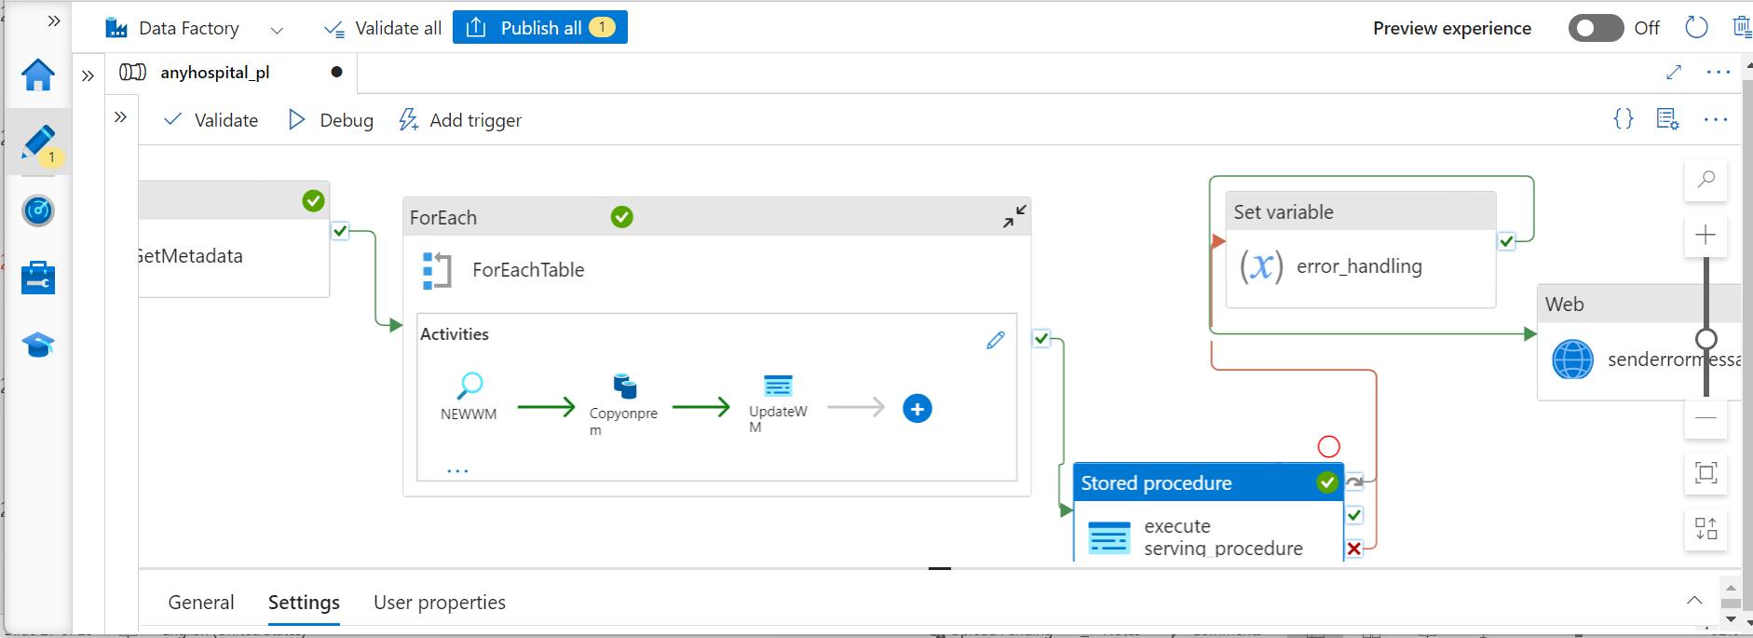
ETL Pipeline

Slide 28
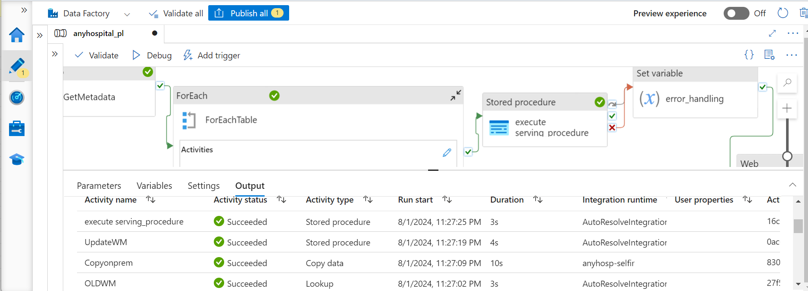
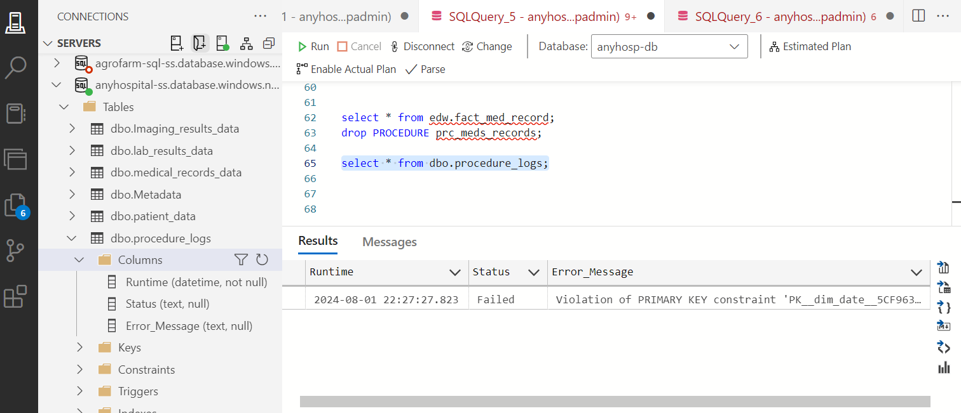
Further Errors

Slide 29
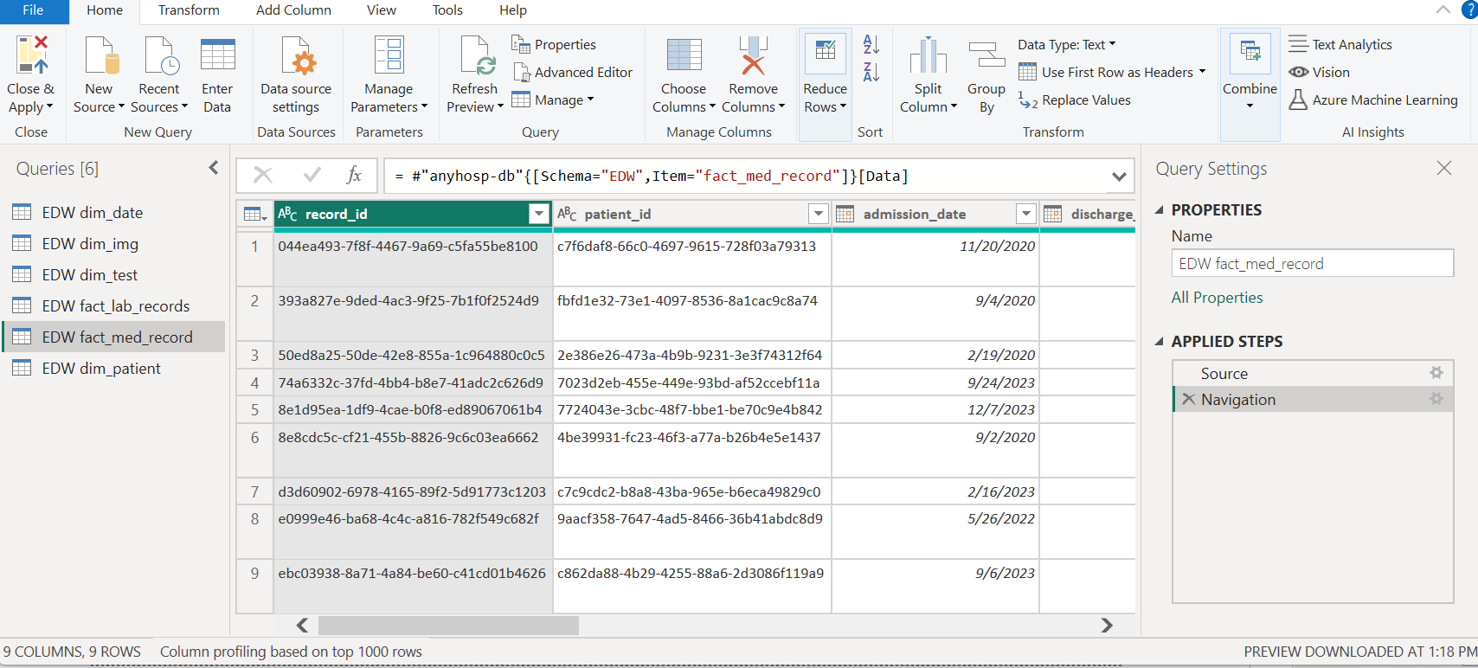
PowerBI Visualization

Slide 30
THANK YOU

